Slide 1
Challenges to Business Analysts in 2023
Dr. Kitty Hung
PhD, CITP, FBCS
2nd March 2023

Slide 2
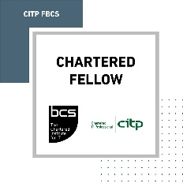
About me
PhD in Computer Science
BCS International Diploma in Business Analysis
BCS Fellow
BCS CITP
1999
2002
2019
2001
2017
2021
University of Sheffield / London Business School
Research Fellow
London
Metropolitan
Police
Senior Business Analyst
Raytheon
Technologies
Lead Consultant in Business Analysis
Cell Structure
Business Analyst
Capita
Business Analyst
Atkins
Principal Consultant in Business Analysis

Slide 3
Agenda
PESTLE Analysis in 2022
Challenges in 2023
Challenges to Business Analysts
Key Takeaways
Opportunities to Business Analysts

Slide 4
PESTLE Analysis in 2022
Political – Russian Invasion to Ukraine, threats from China on invasion to Taiwan, North Korean Missile drills around South Korea
Economic – Covid-19 backlog (manufacturing, logistics), Inflation, Interest rate rise, drop of GDP, Recession
Social – As a result from ‘P’ and ‘E’ - Industrial Actions, Strikes, Protests
Environmental – Sustainability, ESG challenges due to rise of energy price as a result of ‘P’ & ‘E’
Technological – As a result from ‘P’ and ‘E’ - shortage of advanced computer chips, Big Tech Giants’ redundancies
Legal – Cyber Warfare, Cyberthreats, IPR, Lack of regulations in some emerging technologies
P
E
S
T
L
E

Slide 5
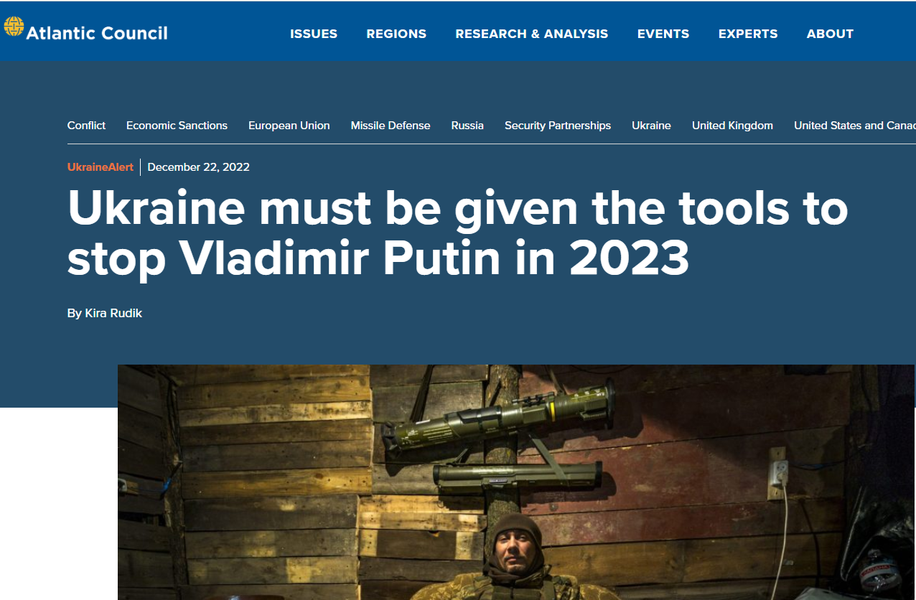
Political – Russian Invasion to Ukraine

Slide 6
Economic – Covid-19 backlog (manufacturing, logistics), Inflation, Interest rate rise, drop of GDP, Recession

Slide 7
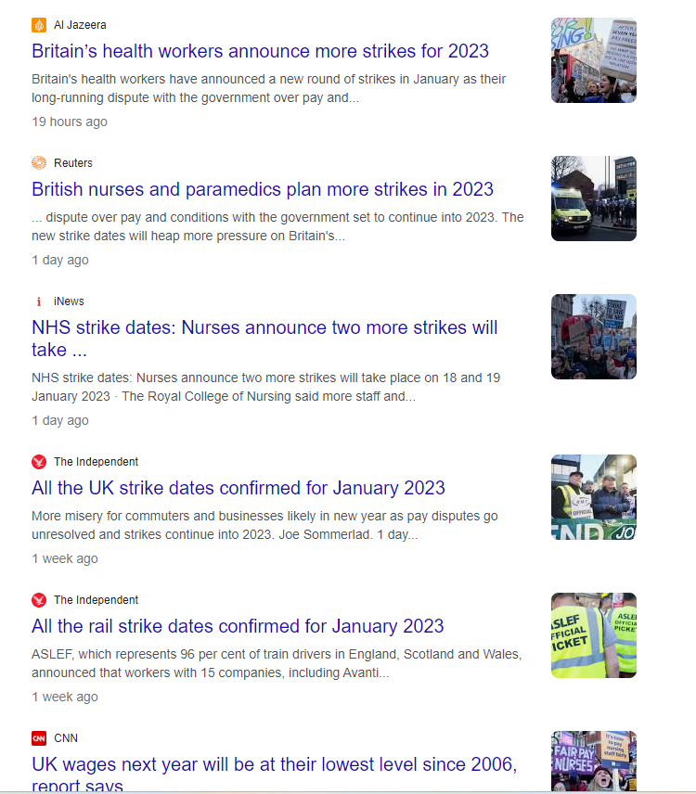
Social – As a result from ‘P’ and ‘E’ - Industrial Actions, Strikes, Protests

Slide 8
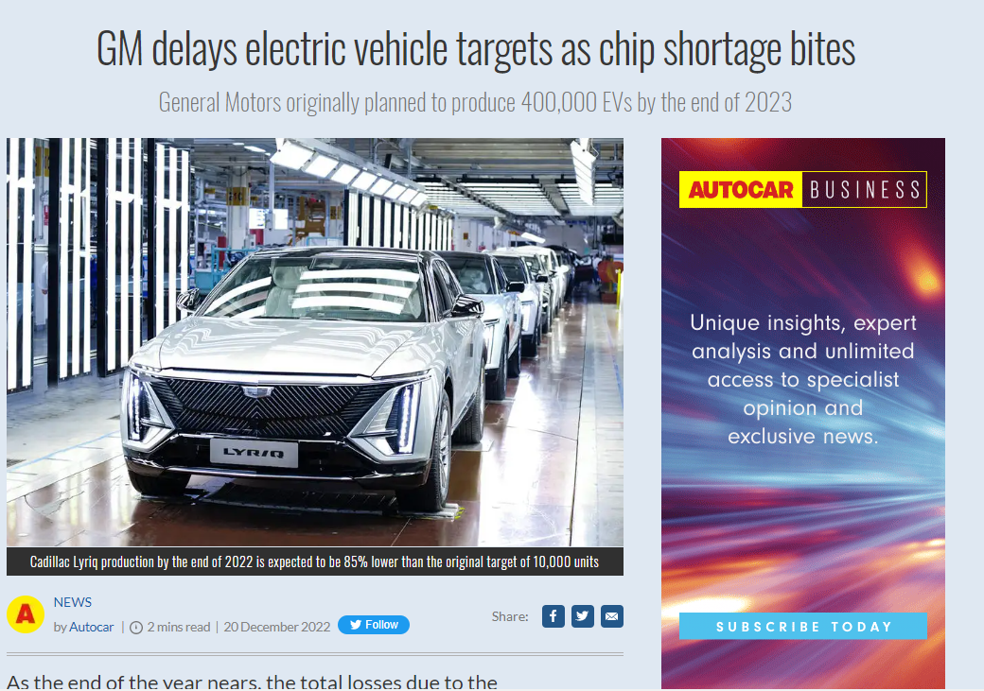
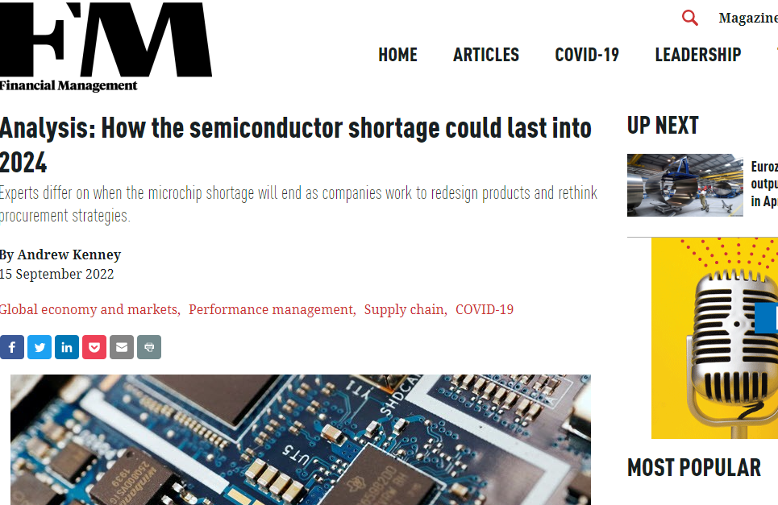
Technological – As a result from ‘P’ and ‘E’ - shortage of advanced computer chips

Slide 9
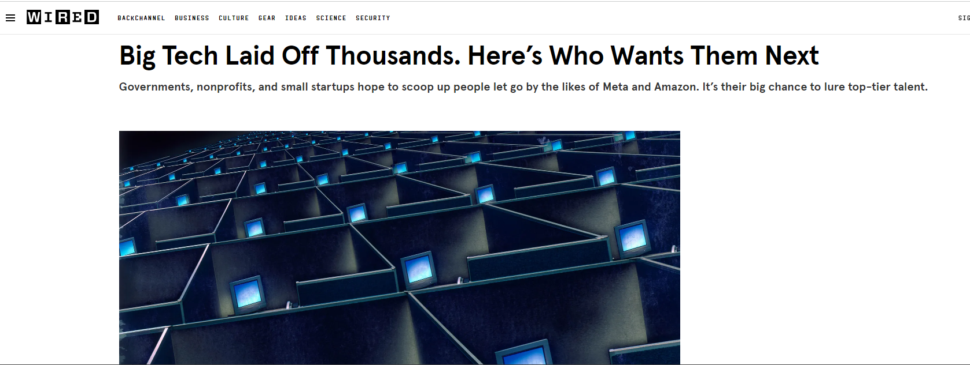
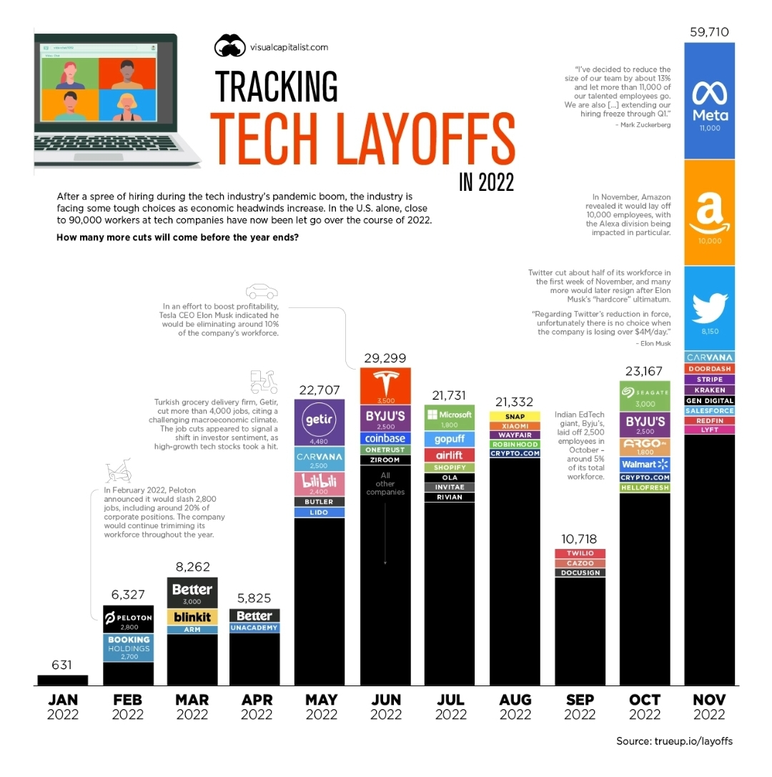
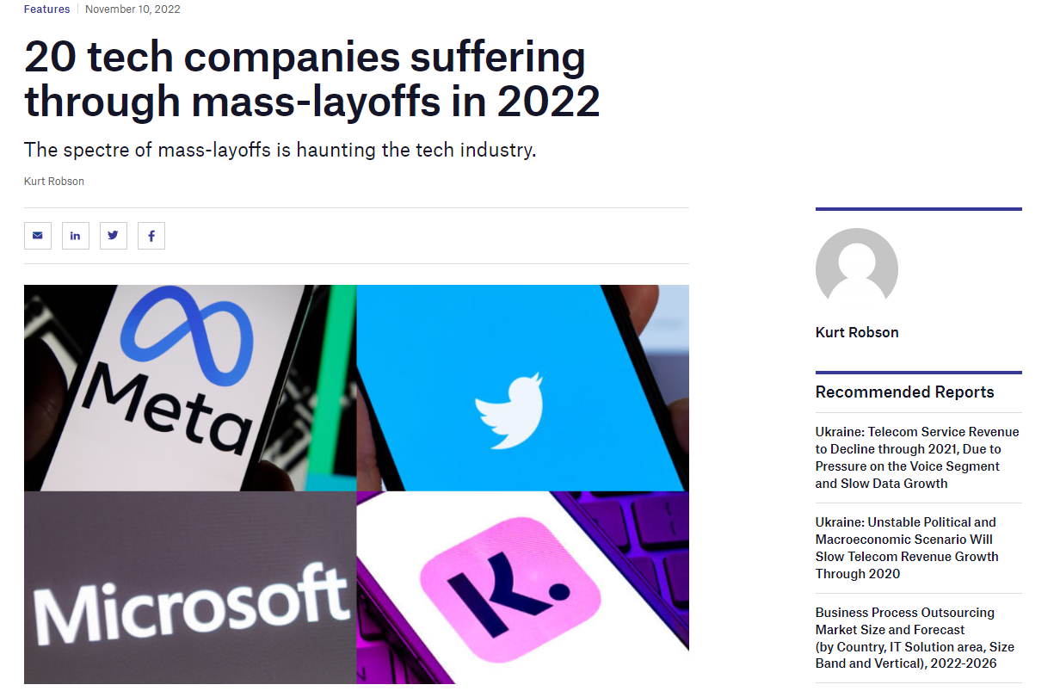
Technological – Big Tech Giants’ redundancies

Slide 10
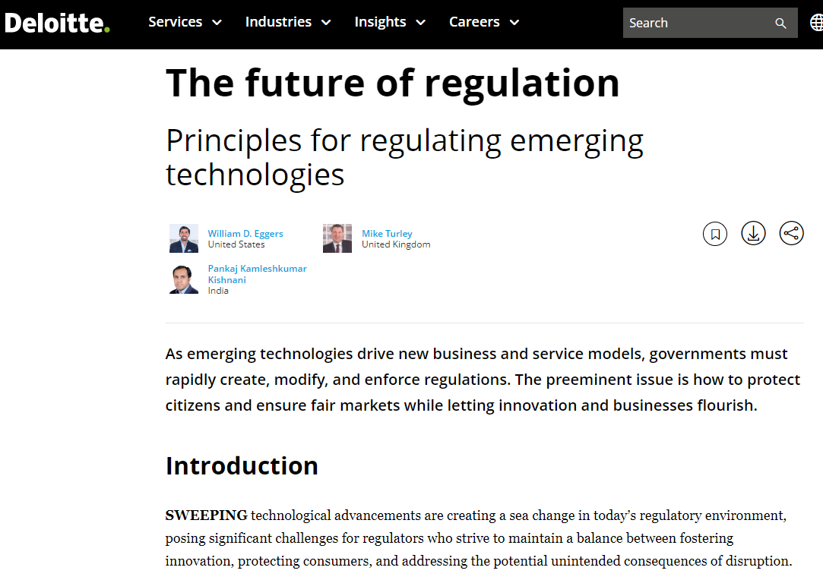
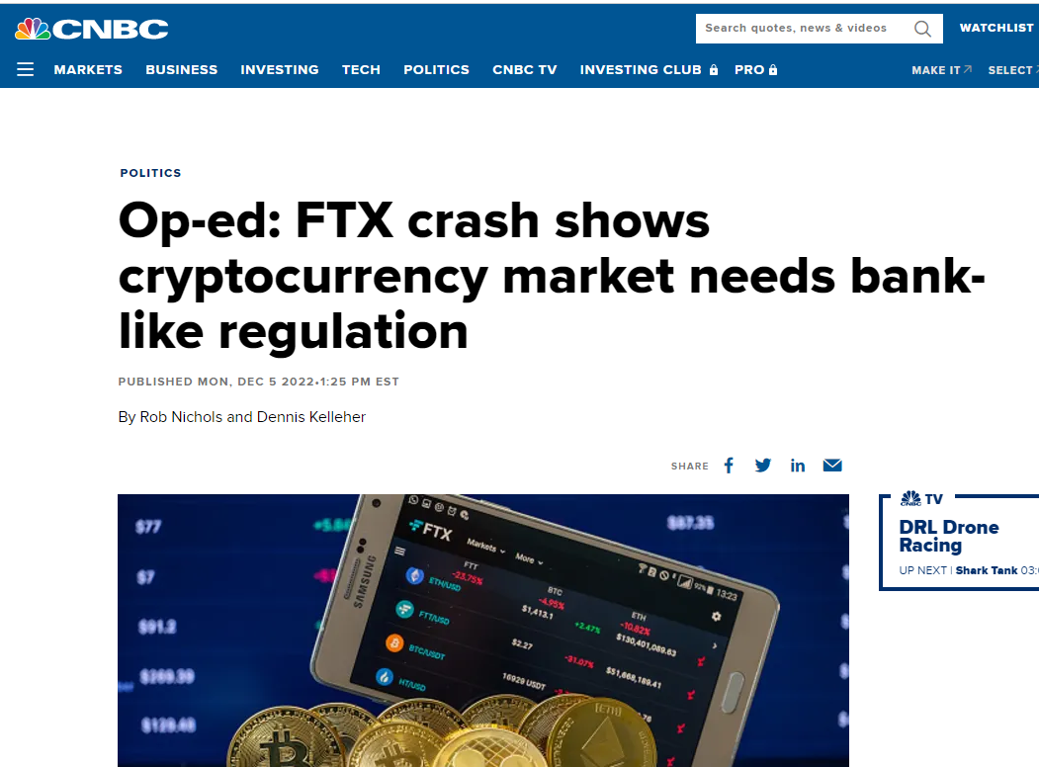
Legal – Cyber Warfare, Cyber Threats, IPR, Lack of regulations in some emerging technologies

Slide 11
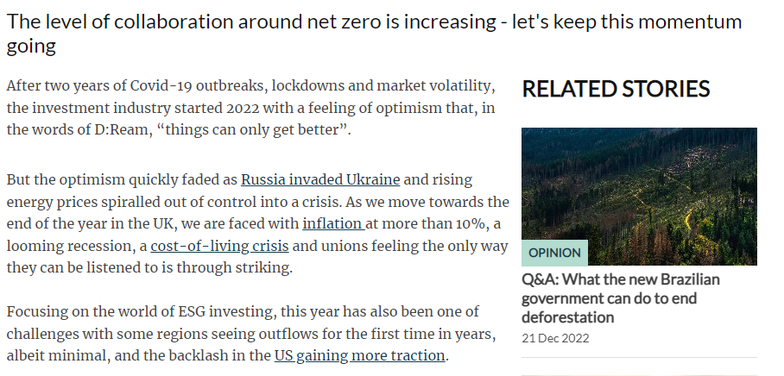
Environmental – ESG challenges due to rise of energy price as a result of ‘P’ & ‘E’
When it comes to energy crisis, most countries will choose energy security over environment & sustainability (e.g.: Germany has reactivated its coal plants after cutting off natural gas supply from Russia)

Slide 12
Challenges in 2023 and beyond
Ongoing uncertainty in global geopolitical situations such as:
Russian Invasion to Ukraine
Threats from China to invade Taiwan
Border conflicts between India and China
North Korean missile drills around South Korea
Covid-19 pandemic – it’s not over yet !
Tackling semi-conductors / computer chips shortages
High cost of energy due to shortages leading to high cost of almost everything else including the investments in innovation projects
Automation to reduce reliance on manual work to combat industry actions and strikes
Regulations on fintech particularly on cryptocurrency market
Developments and advancements in emergence technology including Artificial Intelligence, Machine Learning, Metaverse, Web3, Blockchain, renewable energy, biotechnology, agriculture technology etc.

Slide 13
Challenges to Business Analysts
Adding value to customers and projects by helping them justify the strategic fit, cost and purpose of project initiatives.
Reskilling and upskilling to expand the skill from business analysis to business advisory in order to help customers grow, drive efficiency, save cost, reduce risks, improve cyber security, align to regulations, support sustainability
Developing strong technical expertise in new and emerging technologies such as:
IoT, AI, ML, Robotics, Digital Twin, Metaverse, Quantum computing, Blockchain

Slide 14
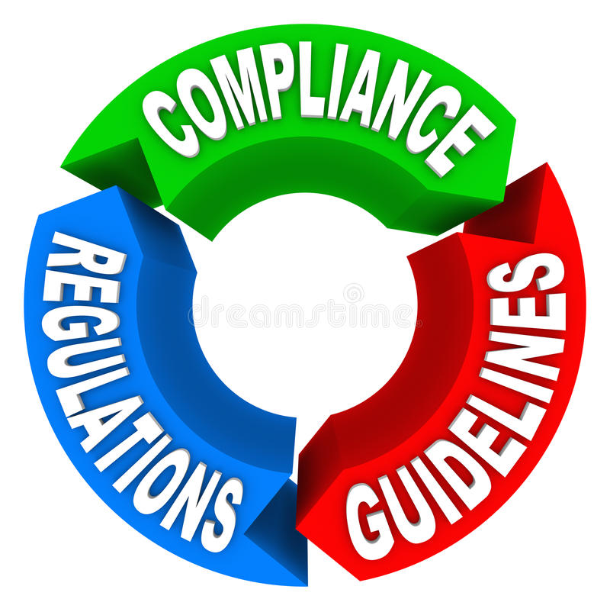
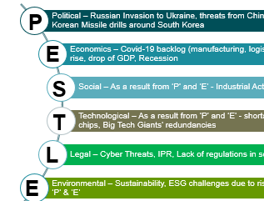
Key Takeaways
What happened in PESTLE does affect the BA’s
Emerging Technologies = Emerging Opportunities to BA’s
Regulations, Compliance, Security, Risks, Ethics
From Business Analysis to Business Advisory

Slide 15
From Business Analysis to Business Advisory
It is crucial to consistently align project initiatives with opportunities for optimisation, cost reduction, and improved performance.
Do not hesitate to question the scope and requirements of a project if you believe they are not cost-effective and present alternative options
In the long term, implementing sustainable practices can not only benefit the environment, but also have a positive impact on a business’s bottom line by reducing costs and increasing efficiency.
Opportunities for adopting renewable energy sources, reducing waste and resource consumption, and implementing environmentally-friendly technology solutions should be carefully considered in order to achieve these benefits.
Efficiency
Cost Savings
Agile Mindset
Auto-mation
Data-Driven Decision-Making
Sustaina-bility
Utilisation of cloud-based solutions can effectively minimise hardware and IT expenses.
Exploring the opportunities for technology-based solutions to decrease energy consumption can also be considered as potential cost savings.
Adopting an Agile mindset not just can enhance the likelihood of success, but also can mitigate risks, ultimately resulting in a reduction of time and financial resources needed for rework.
Utilising data-driven technology to inform decision-making can assist customers in making more informed and astute choices.
Identifying opportunities for automating repetitive tasks and processes, thereby increasing efficiency and freeing up resources for more strategy endeavours.

Slide 16
Opportunities to Business Analysts in Emerging Technology projects

Slide 17
What should Business Analysts know when working on AI / ML projects?
Developing skills in understanding machine learning algorithms in both supervised & unsupervised learning
Understanding how to apply the algorithms to meet business needs
Understanding data management and analytics feeding to the AI and ML models
Identifying potential and opportunities how business can yield benefits from the more advanced AI/ML technology such as deep learning (i.e.: using artificial neural networks for decision making)
Identifying ethical, legal, transparency, privacy and bias issues in AL /ML decision making

Slide 18
What should Business Analysts know when working on IoT projects?
Developing skills in understanding the technologies and protocols used in various Internet of Things (IoT) devices such as sensors, communications, gateways, cloud platforms, cyber security
Understanding data management for IoT data transmission and data exchange such as:
How to help customers utilise the data to help their business grow?
How to make more than what the customers have got in terms of data exploitation?
In addition to the need for cybersecurity, it is crucial for the physical security of IoT devices such as drones, robots, and autonomous vehicles, which may be remotely operated and located at a distance from human controllers, to be safeguarded.
Further information, please read my Thought Leadership article on IoT and Analytics

Slide 19
What should Business Analysts know when working on Metaverse projects?
Developing skills in understanding the Virtual Reality (VR) and Augmented Reality (AR) technologies
Understanding Metaverse User experience (UX) design principals in order to be able to design the Metaverse to provide users with intuitive, engaging and immersive experiences
Ensuring the Metaverse projects are here to help customers drive business values (could be so easy to get carried away by over-designing leading to unnecessary costs and time incurred)
Further information, please read my Thought Leadership article on Business Analysis in the Metaverse

Slide 20
What should Business Analysts know when working on Blockchain projects?
Developing skills in understanding the concept behind blockchain such as:
Decentralised data and records distributed across a network of computers rather than being stored on a single centralised server
Distributed ledger
Consensus algorithms
Smart contracts
Cryptography
Data transparency and auditability
Be aware Cryptocurrency industry which uses blockchain technology is still very much unregulated (e.g.: the collapse of FTX). BA’s will need to decide whether or not to walk out of the project if it goes against their morality and integrity

Slide 21
What should Business Analysts know when working on Robotics projects?
Developing skills in understanding the sensors and actuators used in Robotic devices to communicate with the Robot operator via a computer to guide their movements, performance and decision-making.
Understanding how to apply AI/ML to enable the Robots to perform more complex tasks
Understanding how multiple robots can be connected together securely to perform self-governance and self-autonomy amongst themselves.
Further information, please read my Thought Leadership article on Swarm Intelligence

Slide 22
What should Business Analysts know when working on Digital Twin projects?
Developing skills in understanding computer simulation of physical objects in the real world
Understanding how to ‘model’ the Digital Twin to accurately represent the real-world system or process being simulated
Able to test the behaviour of the Digital Twin and compare against the real world entity
Further information, please read my Thought Leadership article on Business Analysis in the Brave New World

Slide 23
What should Business Analysts know when working on Quantum Computing projects?
Developing skills in understanding technologies and platforms used in Quantum Computing such as:
Qubits
Superposition
Quantum algorithms
Error Correction
Understanding what potential to be applied in a variety of industries eg:
financial modelling
drug discovery
supply chain & traffic optimisation
climate modelling
Understanding whether Quantum Computing is appropriate to the business needs as Quantum Computing could be a very costly project

Slide 24
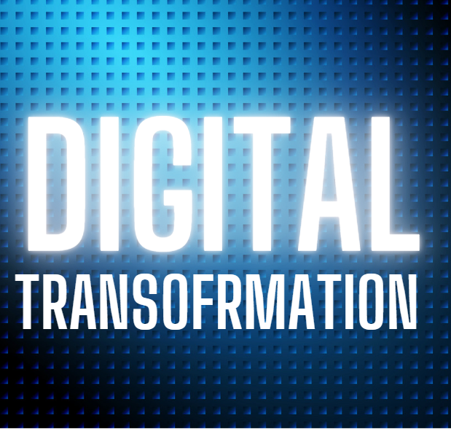
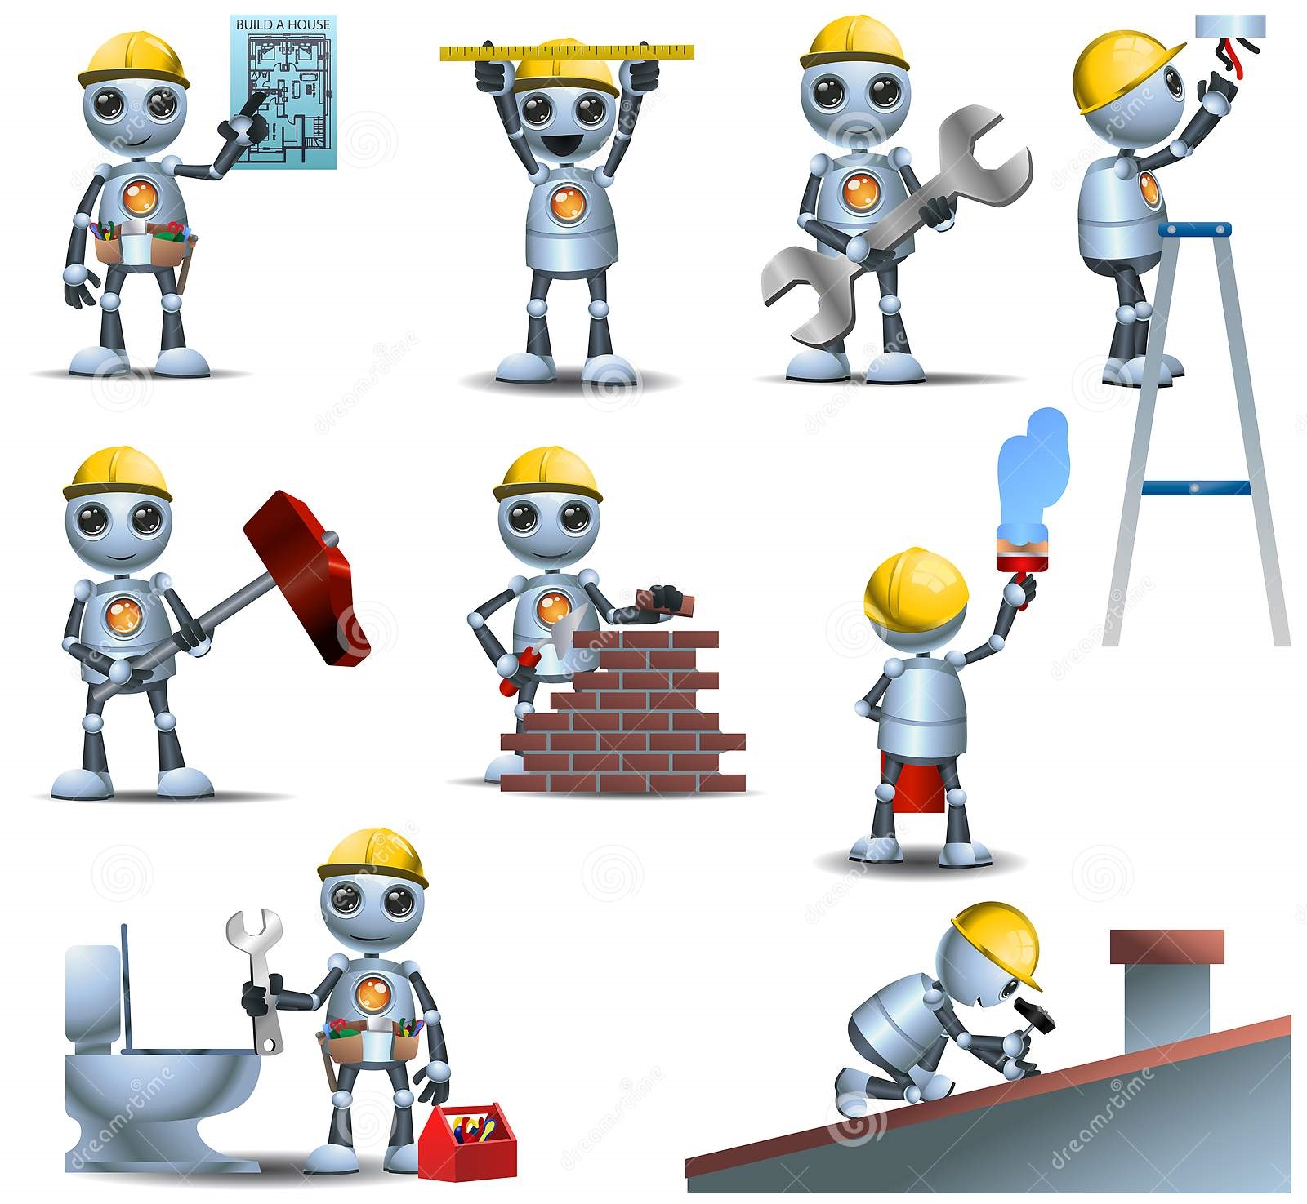
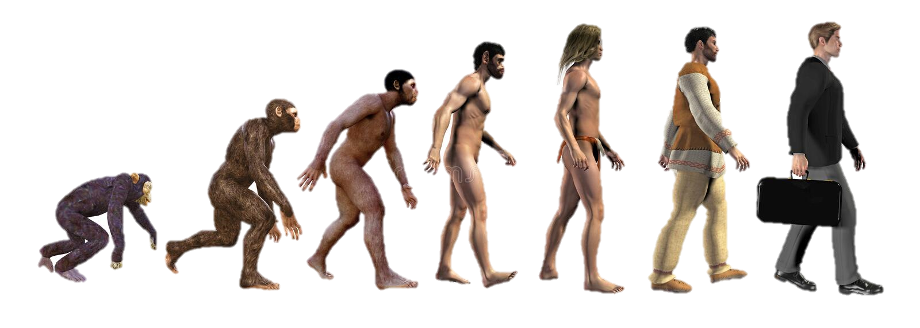
Summary & Conclusion
Digital Transformation
Cybernetic Automation
Physical Automation
Homo Sapiens Evolution

Slide 25
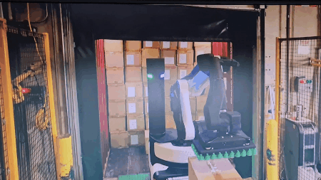
DHL Depot
Source: https://www.youtube.com/watch?v=qgGH6Vk8nY8

Slide 26
Thank You and Q&A
Contact me:

